Slide 1
More RCTs! What to do with imperfect compliance?
Dealing with Data: Class 3
Same deal as always:
Mix up who you sit next to!

Slide 2
Announcements
Isaac’s Office Hours are canceled this week (he’s traveling)

Slide 3

Agenda
Notes on HW
Recap from last time
The problem for today: non-compliance
What we can do about it
Local Average Treatment Effects (LATE)
When LATE doesn’t work
What else we can say
Advertisement: Some of the stuff we’ll talk about today was awarded the 2021 Econ Nobel prize! Important stuff!

Slide 4
Notes on HW!

Slide 5
HW1
Graded! Nice job!
You should be able to see grades + comments on Blackboard
(Please let us know if you can’t)
One note:
One emphasis of this class is on interpretation: a description in words that a non-technical person can understand.
If, based on HW1 feedback, you’d like to redo/update HW2, feel free to do that and hand it in by Friday.
We have no idea how Blackboard works, just email it to us.
marykw@stanford.edu and sorkin@stanford.edu

Slide 6
HW2
We will look + grade soon!
Context:
The paper that this assignment was based on (Lalonde, 1986) was extremely influential.
It convinced many researchers that RCTs (and natural experiments, more next time) are the way to go.
That paper and follow-up work also did some fancier stuff to try to make an artificial “control group” by “re-weighting” things. We’ll revisit that in/after Class 5.

Slide 7
HW3
Available now!
Is actually due before Class 5!
Not next week!
You have two weeks!
It’s (about) the same length as HWs 1 and 2 (we think).
You should be able to start it after today’s class, but you’ll have more context after Class 4.

Slide 8
Recap!

Slide 9

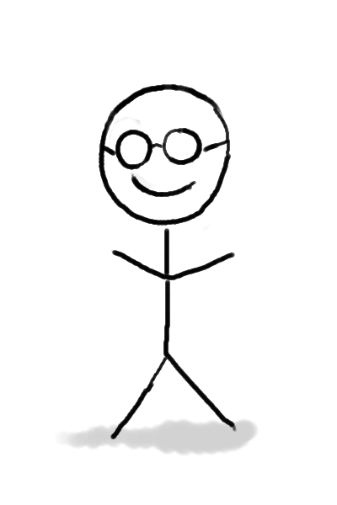

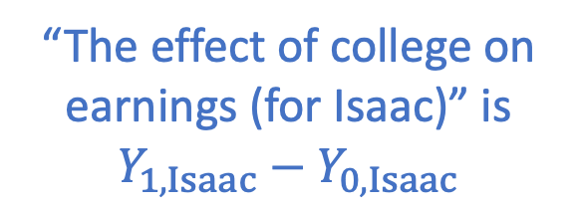

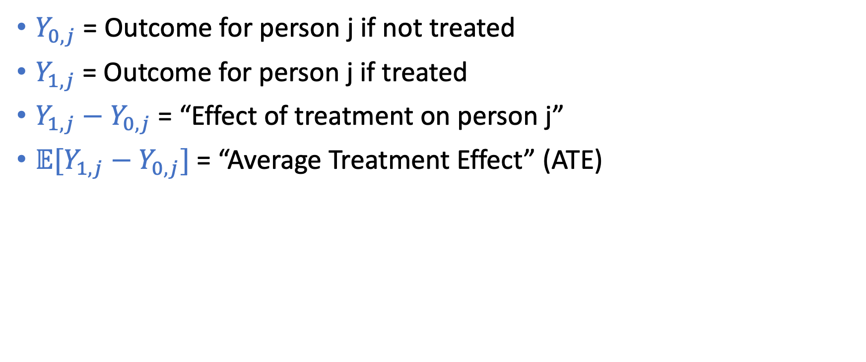

What we want: Average Treatment Effect
$Y_{0,j}$ = Outcome for person j if not treated
$Y_{1,j}$ = Outcome for person j if treated
$Y_{1,j}−Y_{0,j}$ = “Effect of treatment on person j”
$𝔼[Y_{1,j}−Y_{0,j}]$ = “Average Treatment Effect” (ATE)
Earnings: $Y_{0,Isaac}$
Earnings: $Y_{1,Isaac}$
“The effect of college on earnings (for Isaac)” is $Y_{1,Isaac}−Y_{0,Isaac}$
College-Abstaining Isaac
College-Going Isaac

Slide 10

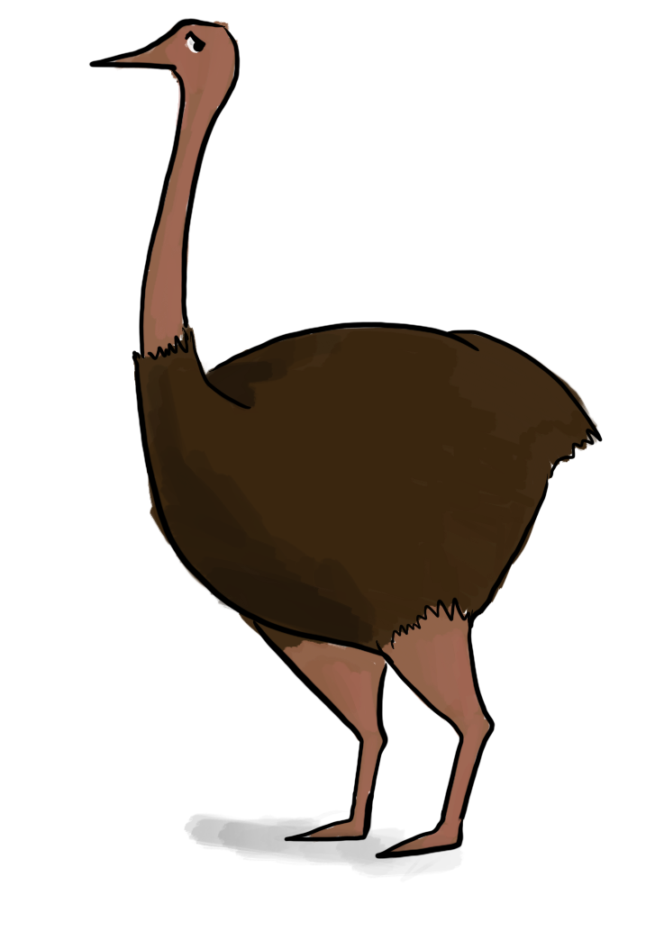



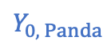
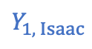
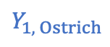
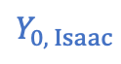
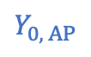
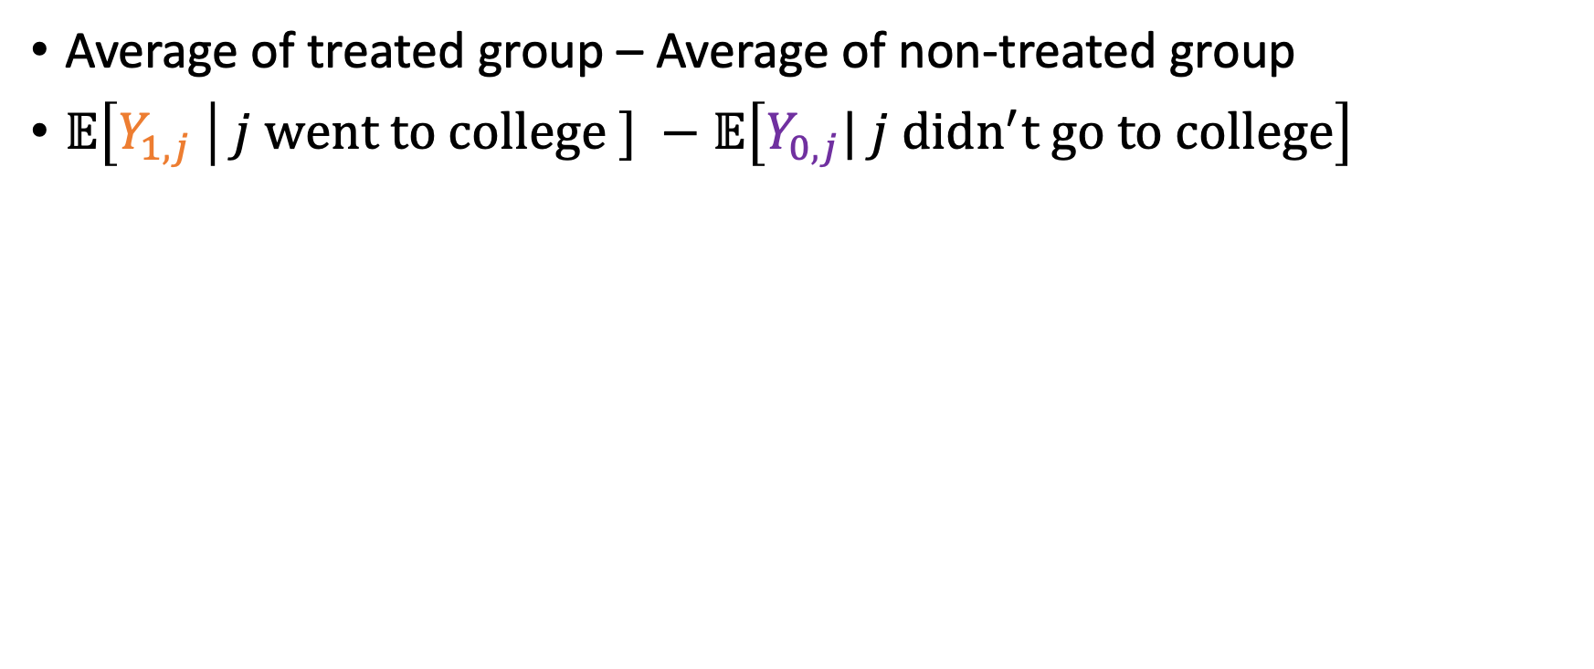
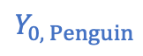
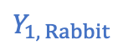
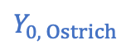
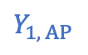
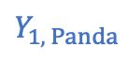
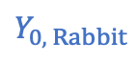
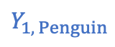
What we have: Observational Comparison
Average of treated group – Average of non-treated group
$𝔼\left[Y_{1,j} \right| j went to college ] −𝔼\left[Y_{0,j}| j didn^{′}t go to college\right]$
Isaac
Panda
Rabbit
Ostrich
Penguin
Alien Penguin
$$Y_{0, Isaac}$$
$$Y_{0, Panda}$$
$$Y_{0, Rabbit}$$
$$Y_{0, Ostrich}$$
$$Y_{0, Penguin}$$
$$Y_{0, AP}$$
????
????
????
$10
$5
$6
$$Y_{1, Isaac}$$
$$Y_{1, Panda}$$
$$Y_{1, Rabbit}$$
$$Y_{1, Ostrich}$$
$$Y_{1, Penguin}$$
$$Y_{1, AP}$$
$10
$15
$11
????
????
????

Slide 11
The Magic of RCTs!
(Average) Observational Effect
Selection on Treatment
Selection on Levels
=
ATE
+
+
In an RCT, these are both zero! Hooray!
Caveats:
Sample sizes should be big enough
The folks in the RCT need to represent population you care about.
The folks in the RCT need to do what they are told...

Slide 12
Example RCT This will be our running example for today...
We can’t randomly send people to college or not.
But we can randomly give them information.
This was quite effective at getting high-achieving low-income students to apply to college.

Slide 13
Idea
We can use this RCT to assess returns to college!
Treatment group:
Folks who randomly got mailers
Control group:
Folks who randomly did not get mailers
Later, see how much more the treatment group earns than the control group.
Researchers have done this.
Researchers will do this in 5-10 years.

Slide 14
Question for today’s class
How should we analyze this experiment?
The main subtlety:
Some people who got the mailer didn’t go to college
Some people who didn’t get the mailer did go to college

Slide 15

Non-Compliance

Slide 16

Examples of non-compliance in RCTs (Basically every RCT that involves humans)
Don’t tell me what to do!
OK
OK
Nah.
Take this medication!
This tastes like sugar! I’m going to go find a doctor who will give me the good stuff.
Researcher
Treatment Group
Take this medication!
(Secretly a placebo)
OK
OK
Nah.
Researcher
Control Group

Slide 17
Examples of non-compliance in RCTs (Basically every RCT that involves humans)
Cool! I’ll go to college now!
I was gonna go anyway, but sure!
I wasn’t going to go to college no matter what.
Here’s some information about college!
Don’t tell me what to do!
Researcher
Treatment Group
I’m going to college no matter what!
I’m not going to college no matter what!
I just love being in debt, I’ll go to college!
College is too expensive...I won’t go
Researcher
Control Group

Slide 18
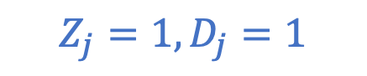
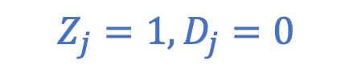
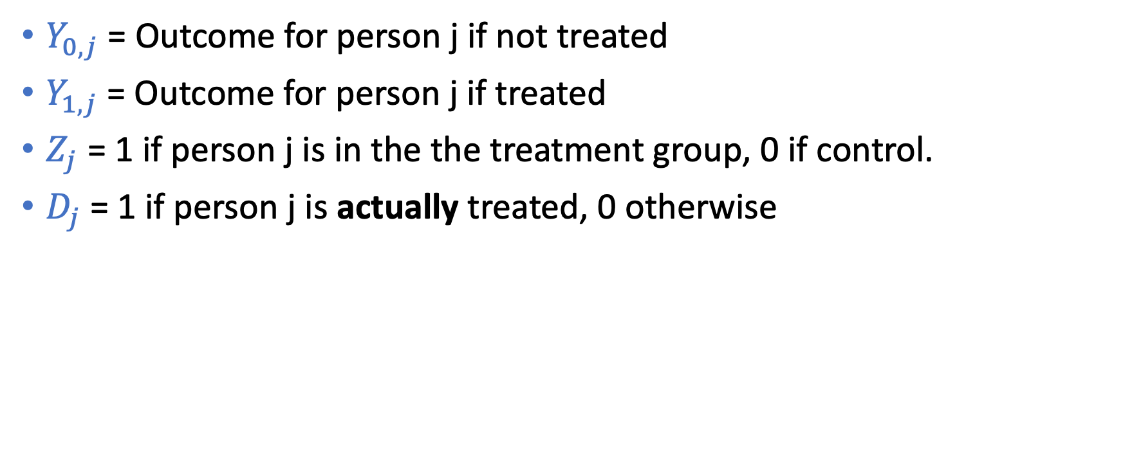
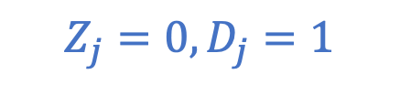
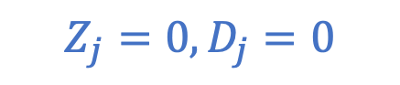
A smidge more notation
$Y_{0,j}$ = Outcome for person j if not treated
$Y_{1,j}$ = Outcome for person j if treated
$Z_{j}$ = 1 if person j is in the the treatment group, 0 if control.
$D_{j}$ = 1 if person j is actually treated, 0 otherwise
Quick exercise: What are $Z_{j}$ and $D_{j}$ for each of these people?
$$Z_{j}=1, D_{j}=0$$
$$Z_{j}=1, D_{j}=1$$
$$Z_{j}=0, D_{j}=0$$
$$Z_{j}=0, D_{j}=1$$

Slide 19
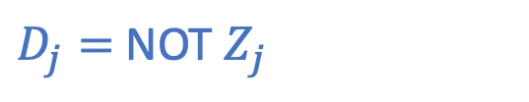
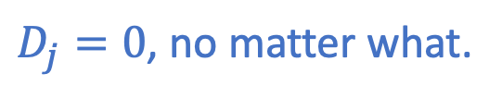


Types of people (for a particular experiment)
Don’t tell me what to do!
Cool! I’ll go to college now!
I was gonna go anyway, but sure!
Thanks but I’m not going no matter what.
I’m going to college no matter what!
I just love being in debt, I’ll go to college!
College is too expensive...I won’t go
I wasn’t going to go anyway...
Compliers
Always-takers
Never-takers
Defiers
$$Z_{j}=D_{j}$$
$D_{j}=1$, no matter what.
$D_{j}=0$, no matter what.
$D_{j}=$ NOT $Z_{j}$

Slide 20
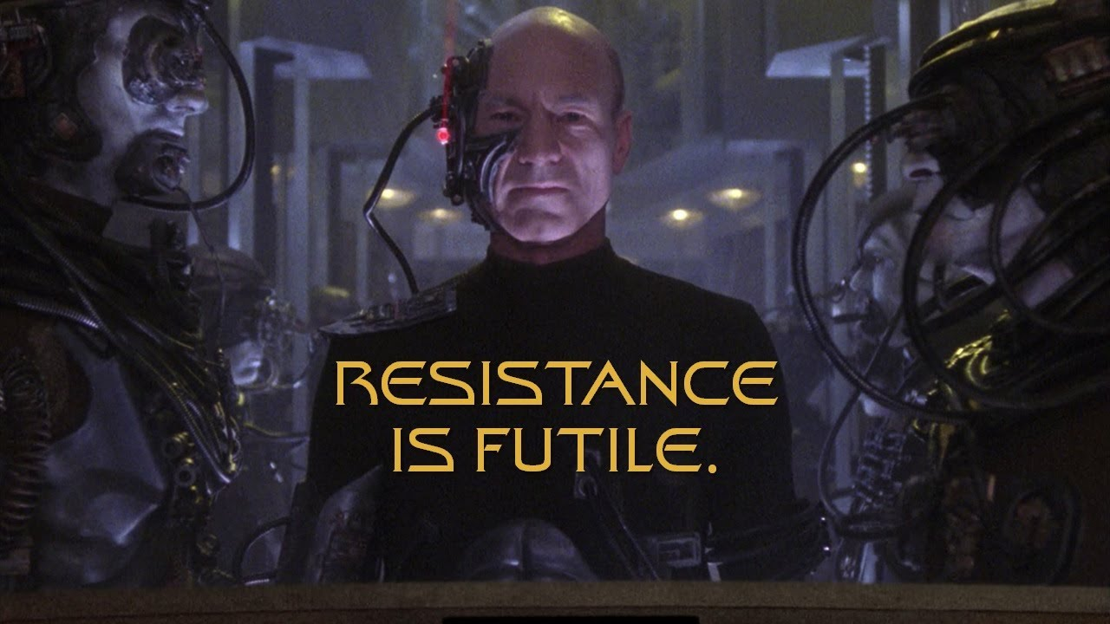
Perfect Compliance
If everyone is a complier...
...that’s great! Our analysis from last week goes through.
If we wanted to estimate the ATE of college on earnings with this RCT, we could do it!
Cool! We’ll go to college now that we know it’s cheap!
We think college is too expensive, so we won’t go.

Slide 21
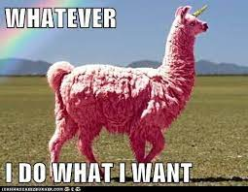
Imperfect compliance
...is not perfect compliance.

Slide 22
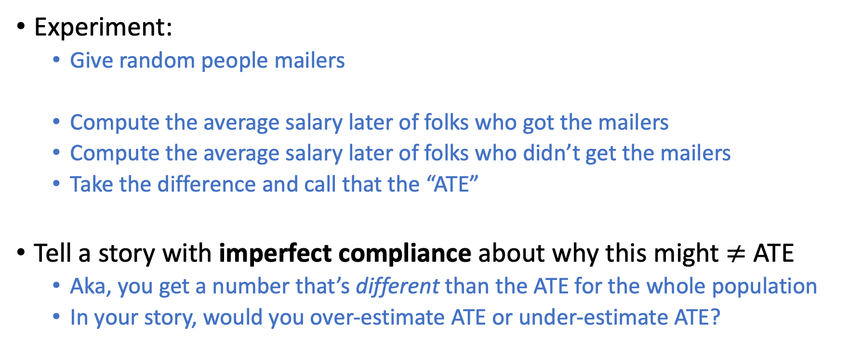
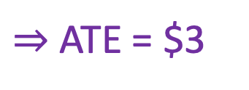
Does this still give the ATE?
Experiment:
Give random people mailers
Compute the average salary later of folks who got the mailers
Compute the average salary later of folks who didn’t get the mailers
Take the difference and call that the “ATE”
Tell a story with imperfect compliance about why this might $≠$ ATE
Aka, you get a number that’s different than the ATE for the whole population
In your story, would you over-estimate ATE or under-estimate ATE?
Discuss!
Treatment group:
Control group:
Average earnings: $10
Average earnings: $7
$⇒$ ATE = $3

Slide 23
Another option: Look at who went to college and who didn’t
Good point -- discuss that too!
Treatment group:
Control group:
Average earnings: $10
Average earnings: $7
$⇒$ ATE = $3

Slide 24
Possible stories (there are lots)
Folks who go to college no matter what are the folks who will get the most out of college.
They would appear equally in both the treatment and control group, so their effect would cancel out – that means we’d underestimate the returns to college in the whole population, since we wouldn’t capture this big effect.
Folks who say “don’t tell me what to do!” are mavericks and would do better without that stifling college education.
We count these folks as “treated” even though they didn’t go to college, see that they make lots of money when “treated” (aka, don’t go to college) and overestimate the returns to college.
General Issues:
Always-takers cancel; and never-takers cancel; so we don’t see them in this estimate
Defiers mean that we conflate “getting the mailer” with “going to college”

Slide 25
Another option: Look at who went to college and who didn’t
Selection effects (both treatment and levels) can creep in:
Folks who go to college even when they think it’s expensive have more “grit” and will make more money anyway.
This may cause us to overestimate ATE, since the folks going to college would make more anyway. (Selection on levels).
Folks who don’t go to college no matter what have other things going on in their lives (e.g., family obligations) so they’d pay less attention to college and get less out of it anyway.
This may cause us to overestimate ATE, since we’re not taking those lower returns to college into account in our average. (Selection on treatment).
Treatment group:
Control group:
Average earnings: $10
Average earnings: $7
$⇒$ ATE = $3

Slide 26
Better LATE than nothing
Local Average Treatment Effects, and what can we say with imperfect compliance?

Slide 27
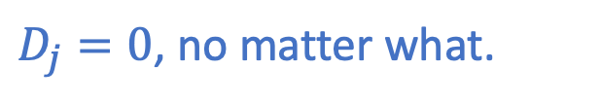
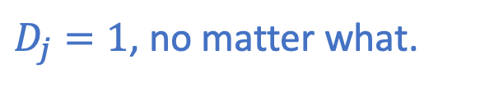

Assume there are no defiers This is called “monotonicity”
Thanks but I’m not going no matter what.
Cool! I’ll go to college now!
I was gonna go anyway, but sure!
College is too expensive...I won’t go
I’m going to college no matter what!
I wasn’t going to go anyway...
Compliers
Always-takers
Never-takers
$$Z_{j}=D_{j}$$
$D_{j}=1$, no matter what.
$D_{j}=0$, no matter what.

Slide 28
Discuss: What can we hope to learn? Assuming no defiers
...About the compliers?
...About the always-takers?
...About the never-takers?
If we look at only the compliers, we can estimate the ATE just on that population.
Caveat: We don’t know who the compliers are!
So we’ll try to do this!
We can’t learn anything about effect of college on them.
Same issue as a single person: we’ll never know the counter-factual.
We can’t learn anything about effect of college on them.
Same issue as a single person: we’ll never know the counter-factual.

Slide 29
New Goal
Instead of trying to compute the ATE for the whole population (which is impossible), try to compute ATE for just the compliers.
Note! Who is a “complier” may vary from experiment to experiment. So even if we “succeed” in our goal, we could get different “correct” answers.
We’re set in our ways
We’re set in our ways
OK
OK
OK
OK
OK
OK
Experiment 1
Experiment 2

Slide 30
New Goal
Instead of trying to compute the ATE for the whole population (which is impossible), try to compute ATE for just the compliers.
This quantity is called the Local Average Treatment Effect (LATE)
It’s “local” to a particular experiment
That means that the LATE for one experiment might not be the same as the LATE for a different experiment

Slide 31
Example! Still no defiers
There are 100 people in the world:
40 compliers
30 always-takers
30 never-takers
$1
$1
$2
$5
$8
$4

Slide 32
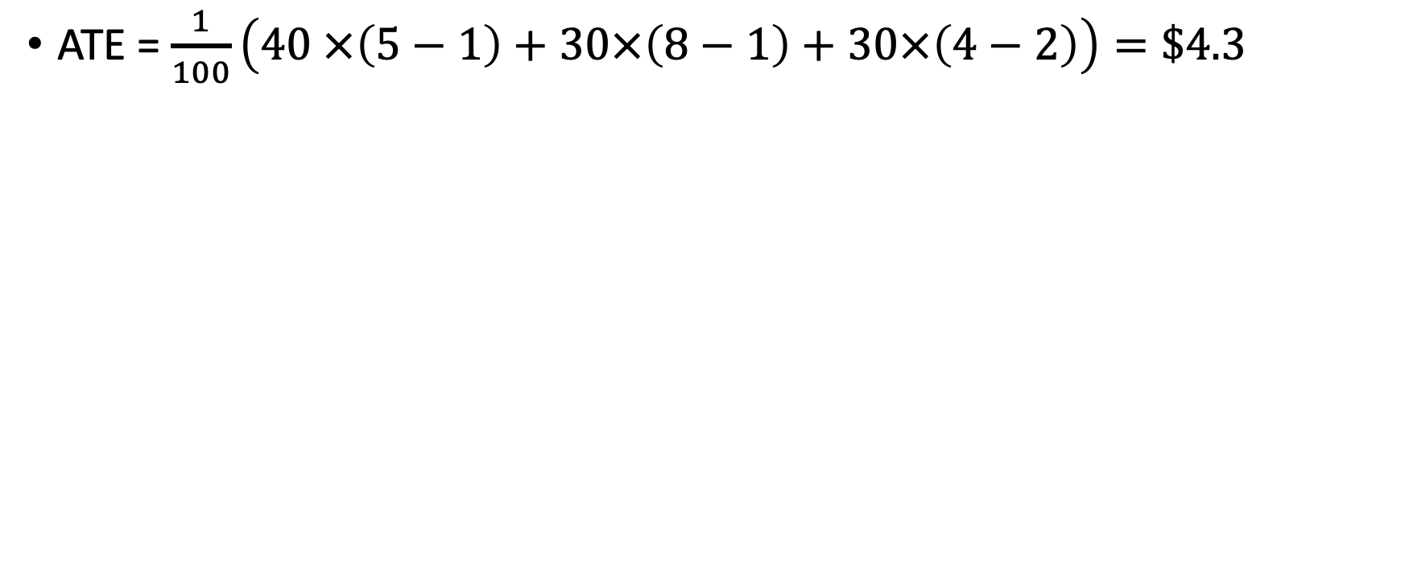
Compute the ATE
ATE = $\frac{1}{100}\left(40 ×\left(5−1\right)+30×\left(8−1\right)+30×\left(4−2\right)\right)=\$4.3$
40 compliers
30 always-takers
30 never-takers
$1
$1
$2
$5
$8
$4

Slide 33
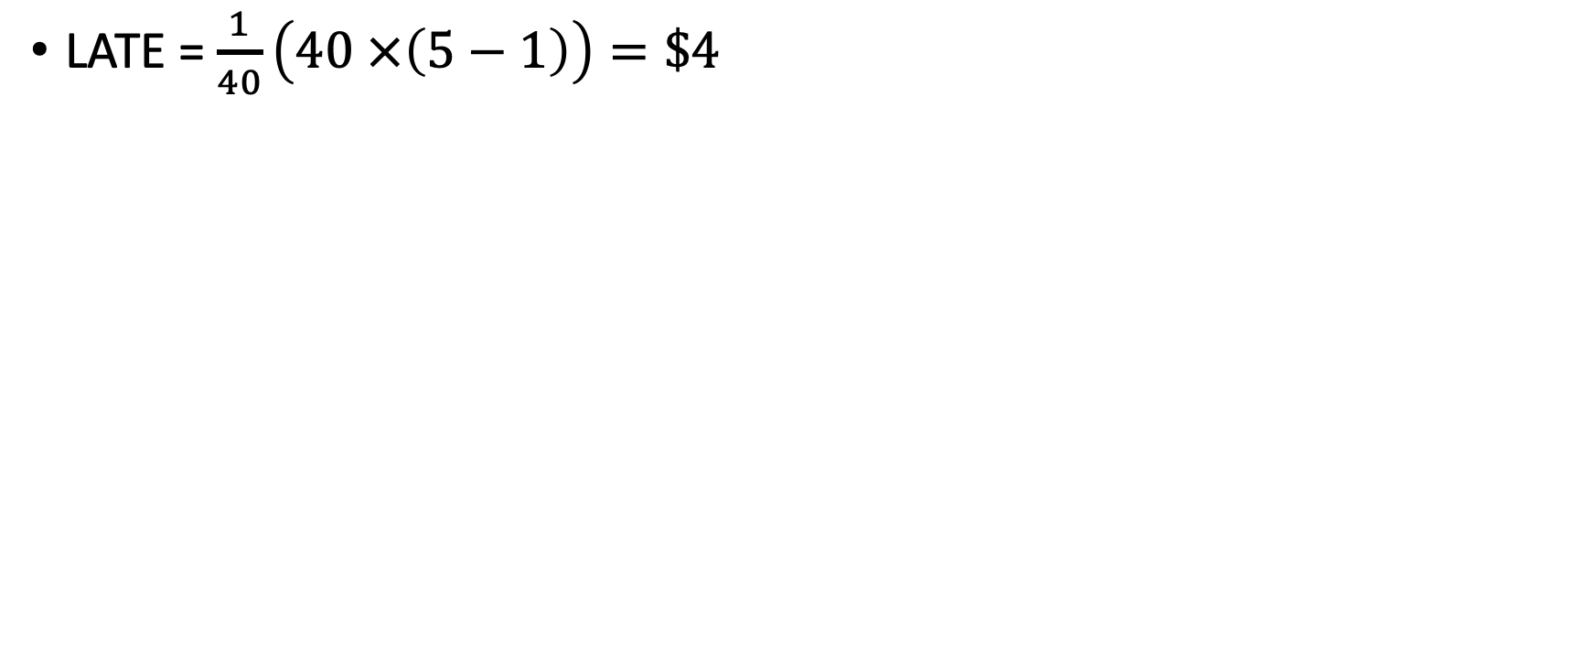
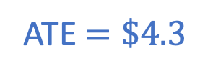
Compute the LATE (LATE = ATE on the compliers)
ATE $=\$4.3$
LATE = $\frac{1}{40}\left(40 ×\left(5−1\right)\right)=\$4$
40 compliers
30 always-takers
30 never-takers
$1
$1
$2
$5
$8
$4

Slide 34
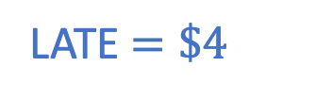
Great! LATE computed!
ATE $=\$4.3$
LATE $=\$4$
It’s $4! Woohoo!
Wait....we don’t know who the compliers are!!!!
40 compliers
30 always-takers
30 never-takers
$1
$1
$2
$5
$8
$4

Slide 35
What do we actually see?
ATE $=\$4.3$
LATE $=\$4$
Let’s say we get lucky and our RCT splits up each set in half.
40 compliers
30 always-takers
30 never-takers
$1
$1
$2
$5
$8
$4

Slide 36
What do we actually see?
ATE $=\$4.3$
LATE $=\$4$
Let’s say we get lucky and our RCT splits up each set in half.
40 compliers
20 treatment 20 control
30 always-takers
15 treatment 15 control
30 never-takers
15 treatment 15 control
$1
$1
$2
$5
$8
$4

Slide 37
What do we actually see?
ATE $=\$4.3$
LATE $=\$4$
Let’s say we get lucky and our RCT splits up each set in half.
40 compliers
20 treatment 20 control
30 always-takers
15 treatment 15 control
30 never-takers
15 treatment 15 control
???
$1
$1
$2
$5
???
$8
$4

Slide 38
What do we actually see?
ATE $=\$4.3$
LATE $=\$4$
Let’s say we get lucky and our RCT splits up each set in half.
40 compliers
20 treatment 20 control
30 always-takers
15 treatment 15 control
30 never-takers
15 treatment 15 control
???
$1
???
???
$2
$5
???
$8
$8
$4

Slide 39
What do we actually see?
ATE $=\$4.3$
LATE $=\$4$
Let’s say we get lucky and our RCT splits up each set in half.
40 compliers
20 treatment 20 control
30 always-takers
15 treatment 15 control
30 never-takers
15 treatment 15 control
???
$1
???
???
$2
$2
$5
???
$8
$8
???
???

Slide 40
Here’s what we actually see How do we find the LATE?
ATE $=\$4.3$
LATE $=\$4$
20 people
15 people
15 people
15 people
20 people
15 people
???
???
???
$2
$1
$2
$5
$8
$8
???
???
???

Slide 41
What does our experiment do?
ATE $=\$4.3$
LATE $=\$4$
(Average in treatment group) – (Average in control group)
That’s not right!!!
$$\frac{1}{50}\left(20×5+15×8+15×2\right)−\frac{1}{50}\left(15×8+20×1+15×2\right)=\$1.6$$
20 people
15 people
15 people
15 people
20 people
15 people
???
???
???
$2
$1
$2
$5
$8
$8
???
???
???

Slide 42


How to fix it!
Intuitively, the problem is that we’re not taking into account the effect of on
We’re computing the effect of on
We want the effect of on
Morally:
This is sort of like the chain rule from calculus!
(if you don’t remember/haven’t seen that, don’t worry about it)
Effect of
on
Effect of
on
Effect of
on
$$×$$
$$=$$

Slide 43



How to fix it continued!
Effect of
on
Effect of
on
Effect of
on
$$×$$
$$=$$
So...
We just computed this
Effect of
on
Effect of
on
$$=$$
Effect of
on
So...let’s compute this and divide by it?

Slide 44
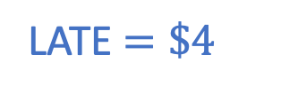
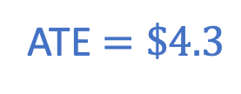
What does our experiment do?
ATE $=\$4.3$
LATE $=\$4$
(Average in treatment group) – (Average in control group)
$$\frac{1}{50}\left(20×5+15×8+15×2\right)−\frac{1}{50}\left(15×8+20×1+15×2\right)=\$1.6$$
20 people
15 people
15 people
15 people
20 people
15 people
???
???
???
$2
$1
$2
$5
$8
$8
???
???
???

Slide 45
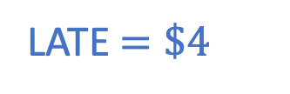
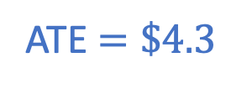
What does our experiment do?
ATE $=\$4.3$
LATE $=\$4$
(Average in treatment group) – (Average in control group)
Effect of
on
$$\frac{1}{50}\left(20×5+15×8+15×2\right)−\frac{1}{50}\left(15×8+20×1+15×2\right)=\$1.6$$
20 people
15 people
15 people
15 people
20 people
15 people
???
???
???
$2
$1
$2
$5
$8
$8
???
???
???

Slide 46

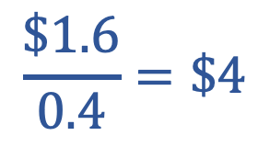

Computing LATE
ATE $=\$4.3$
LATE $=\$4$
(Average in treatment group) – (Average in control group)
Effect of
on
$$\frac{1}{50}\left(20×5+15×8+15×2\right)−\frac{1}{50}\left(15×8+20×1+15×2\right)=\$1.6$$
(Average in treatment group) – (Average in control group)
Effect of
on
$$\frac{1}{50}\left(20×1+15×1+15×0\right)−\frac{1}{50}\left(15×1+20×0+15×0\right)=0.4$$
WHOA that is the LATE!!!
Effect of
on
$$\frac{\$1.6}{0.4}=\$4$$
20 people
15 people
15 people
15 people
20 people
15 people
$$=$$
???
???
???
$2
$1
$2
$5
$8
$8
???
???
???

Slide 47
You should have several questions
Why exactly did that work?
Why did that compute the LATE (and not, say, the ATE or some other sort of effect of college on earnings)
Why did we need the assumption of no defiers?
Basic answer: The never-takers and always-takers cancel out:
So the only reason this isn’t already the LATE is because we are dividing by 50 instead of 20. What we just did renormalized correctly.
$$\frac{1}{50}\left(20×5+15×8+15×2\right)−\frac{1}{50}\left(15×8+20×1+15×2\right)=\$1.6$$

Slide 48


Recap: LATE
Suppose there are no defiers
We can’t hope to learn anything about effect of college on always-takers or never-takers
So let’s hope to learn ATE on the compliers, aka, LATE
We can do it! (Even though we don’t know who the compliers are)
Effect of
on
LATE $=$
Effect of
on
$$=$$
Effect of
on
Compute each of these in the natural way:
(Avg over treatment group) – (Avg over control group)

Slide 49
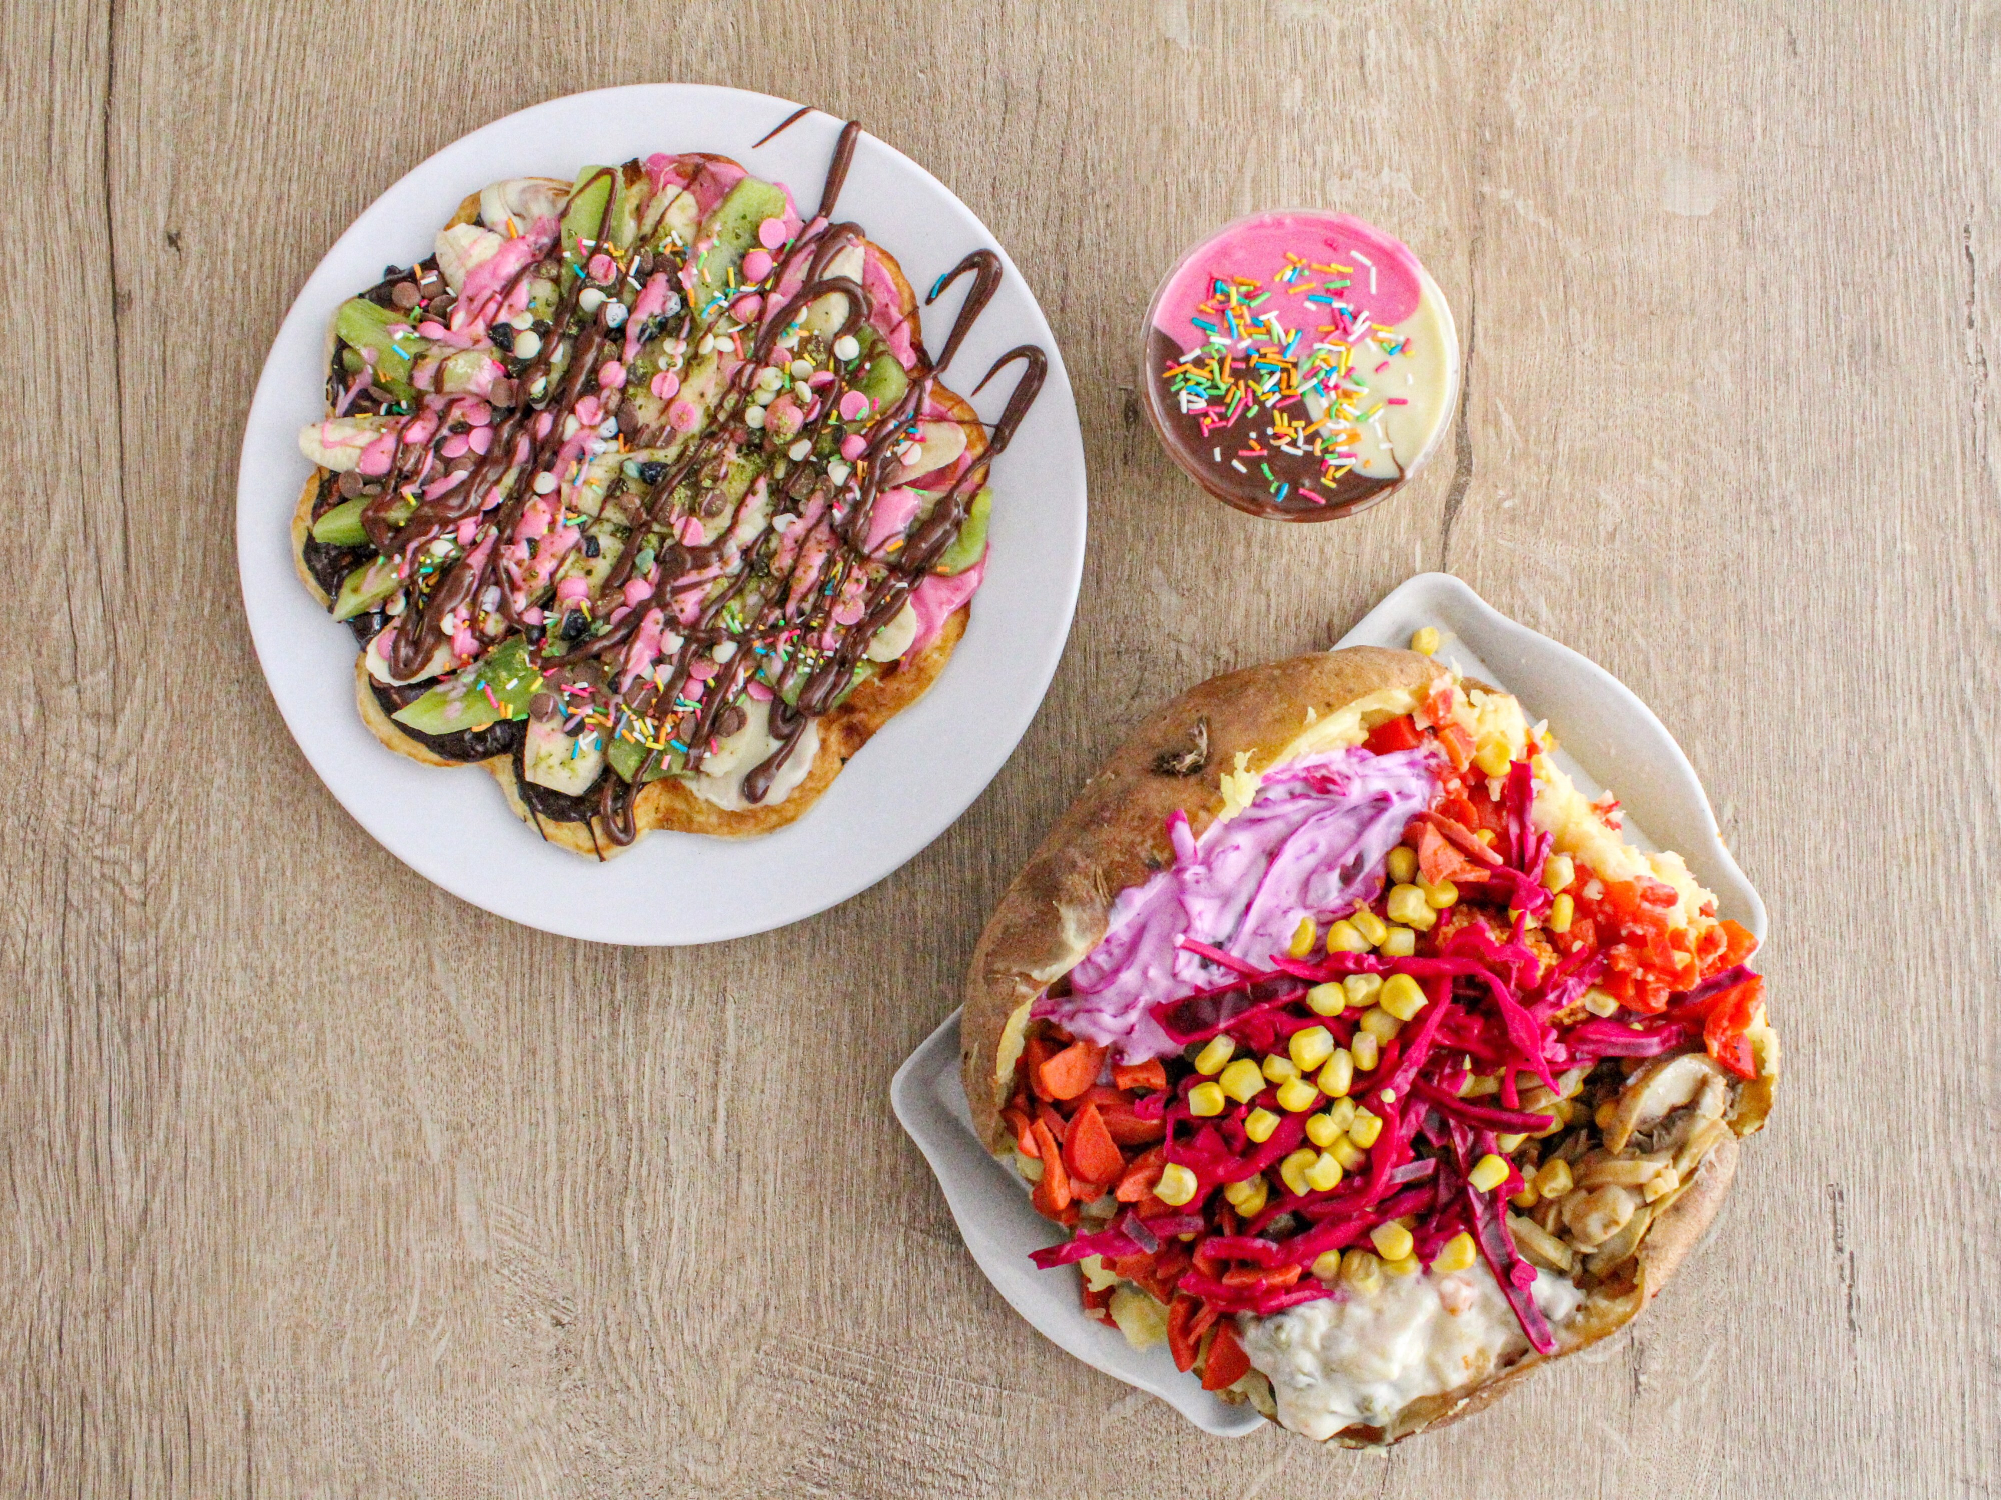
Question during the break
Why do waffles and kumpir go together?
(Serious question)

Slide 50

What if there are defiers?

Slide 51
The same experiment, with some defiers
Don’t tell me what to do!
There are 120 people in the world:
40 compliers
30 always-takers
30 never-takers
20 defiers
$1
$1
$2
$2
$5
$8
$4
$11

Slide 52
What we actually see
Added these 20 people...but we don’t know that!
20 people
15 people
15 people
10 people
10 people
15 people
20 people
15 people
???
???
???
???
$2
$2
$1
$2
$8
$8
???
???
???
$5
$11
???

Slide 53
Let’s do the same thing...
Effect of
on
$$=\frac{1}{60}\left(20×5+15×8+10×2+15×2\right)−\frac{1}{60}\left(15×8+10×11+20×1+15×2\right)$$
Effect of
on
20 people
15 people
15 people
10 people
10 people
15 people
20 people
15 people
???
???
???
???
$2
$2
$1
$2
$8
$8
???
???
???
$5
$11
???

Slide 54
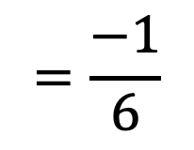
Let’s do the same thing...
$$=\frac{−1}{6}$$
Effect of
on
Effect of
on
$$=\frac{1}{60}\left(20×1+15×1+10×0+15×0\right)−\frac{1}{60}\left(15×1+10×1+20×0+15×0\right)$$
20 people
15 people
15 people
10 people
10 people
15 people
20 people
15 people
???
???
???
???
$2
$2
$1
$2
$8
$8
???
???
???
$5
$11
???

Slide 55
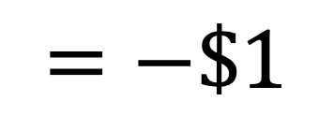
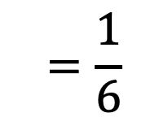
Let’s do the same thing...
$$=\frac{−1}{6}$$
Effect of
on
This is very strange!
All of the groups had positive returns to college.
But we estimated a negative return to college!
$$=−\$1$$
$$=\frac{1}{6}$$
Effect of
on
20 people
15 people
15 people
10 people
10 people
15 people
20 people
15 people
These are “switched” from what they “should” be, and that’s throwing off our estimate!
???
???
???
???
$2
$2
$1
$2
$8
$8
???
???
???
$5
$11
???

Slide 56

Take-Away
Defiers in RCTs mess things up!
We already couldn’t compute the ATE
Now we can’t even compute the LATE!
There are some things you can do to try to mitigate this
(Ask Isaac)
Often it’s “reasonable” to assume there are no defiers.
For most people, information makes them more likely to go to college.

Slide 57
What can we learn about the compliers?

Slide 58
Assume again that there are no defiers Only compliers, always-takers, never-takers
In particular, our LATE computation works.

Slide 59
A few follow-up questions...
Hey, there’s this cool thing called LATE! We can learn the average treatment effect for the population of compliers! It’s $4!
Neat! Is that a big population?
Um, I dunno.
Okay, is $4 big or small compared to average earnings in this population?
Um, I dunno.
Okay, is that population at all representative of the larger population?
Um, I dunno.
Do you know anything?
You’re really raining on my parade here...

Slide 60
We can actually answer these questions!
Let’s see how!

Slide 61
Q1: How many compliers are there? Reprise of our example with 100 people; no defiers
What can we say about these people?
Compliers? Always-takers? Never-takers?
Always-takers!
35 people
15 people
These people?
Always-takers or compliers!
These people?
Never-takers!
15 people
35 people
These people?
Never-takers or compliers!

Slide 62
Q1: How many compliers are there? Reprise of our example with 100 people; no defiers
Assume that the always-takers got split evenly into treatment and control.
The power of randomness!
How many always-takers here?
35 people
15 people
Always-takers or compliers!
Always-takers!
15, same as control group!
So how many compliers are here?
15 people
35 people
35 – 15 = 20
Never-takers!
Never-takers or compliers!
How about here?
Also 20, by the same argument!

Slide 63
A few follow-up questions...
Hey, there’s this cool thing called LATE! We can learn the average treatment effect for the population of compliers! It’s $4!
Neat! Is that a big population?
Um, I dunno.
40 people out of 100
Okay, is $4 big or small compared to average earnings in this population?
Um, I dunno.
Okay, is that population at all representative of the larger population?
Um, I dunno.
Do you know anything?
You’re really raining on my parade here...

Slide 64
A few follow-up questions...
Hey, there’s this cool thing called LATE! We can learn the average treatment effect for the population of compliers! It’s $4!
Neat! Is that a big population?
Um, I dunno.
40 people out of 100
Okay, is $4 big or small compared to average earnings in this population?
Um, I dunno.
Okay, is that population at all representative of the larger population?
Um, I dunno.
Do you know anything?
You’re really raining on my parade here...

Slide 65
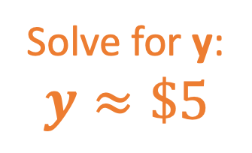
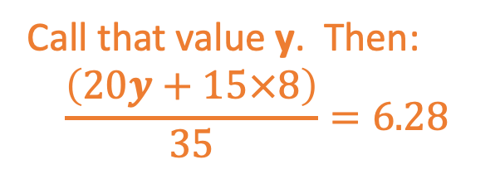
Q2: Average earnings for compliers? Reprise of our example with 100 people; no defiers
What is the average income among the 15 always-takers here?
35 people with avg $6.28
15 people with avg $8
$8
15 always-takers 20 compliers!
Always-takers!
What is the average income among the 15 always-takers here?
Also about $8 (yay randomness!)
15 people with avg $2
35 people with avg $1.42
What is the average income among the 20 compliers here?
Never-takers!
15 never-takers, 20 compliers!
Call that value y. Then:
$$\frac{\left(20y+15×8\right)}{35}=6.28$$
Solve for y:
$$y≈\$5$$

Slide 66
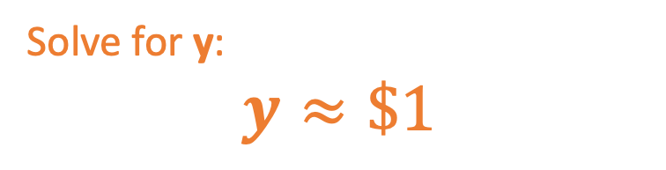
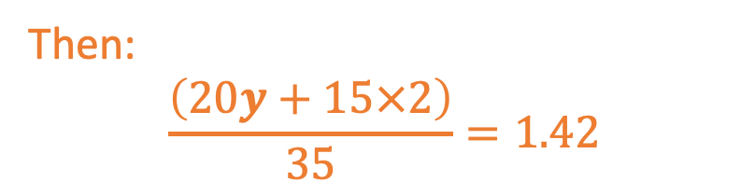
Q2: Average earnings for compliers? Reprise of our example with 100 people; no defiers
What is the average income among the 20 compliers here?
35 people with avg $6.28
15 people with avg $8
Call that value y.
15 always-takers 20 compliers!
Always-takers!
Avg income among the 15 never-takers in that square is about $2.
15 people with avg $2
Then:
$$\frac{\left(20y+15×2\right)}{35}=1.42$$
35 people with avg $1.42
Never-takers!
15 never-takers, 20 compliers!
Solve for y:
$$y≈\$1$$

Slide 67
A few follow-up questions...
Hey, there’s this cool thing called LATE! We can learn the average treatment effect for the population of compliers! It’s $4!
Neat! Is that a big population?
Um, I dunno.
40 people out of 100
Okay, is $4 big or small compared to average earnings in this population?
Um, I dunno.
Avg in treatment group is $5; avg in control was $1; so $4 seems big.
Okay, is that population at all representative of the larger population?
Um, I dunno.
Do you know anything?
You’re really raining on my parade here...

Slide 68
A few follow-up questions...
Hey, there’s this cool thing called LATE! We can learn the average treatment effect for the population of compliers! It’s $4!
Neat! Is that a big population?
Um, I dunno.
40 people out of 100
Okay, is $4 big or small compared to average earnings in this population?
Um, I dunno.
Avg in treatment group is $5; avg in control was $1; so $4 seems big.
Okay, is that population at all representative of the larger population?
Um, I dunno.
Do you know anything?
You’re really raining on my parade here...

Slide 69
Q3: Fraction of women among compliers? Reprise of our example with 100 people; no defiers; say 50% women overall
If time: discuss! You figure it out!
(If not time we’ll do it as a class)
35 people
20 women
15 people
8 women
15, always-takers 20 compliers!
Always-takers!
15 people
5 women
35 people
17 women
Never-takers!
15 never-takers, 20 compliers!

Slide 70
Q3: Fraction of women among compliers? Reprise of our example with 100 people; no defiers; say 50% women overall
What is the number of women among the 15 always-takers here?
35 people
20 women
15 people
8 women
8
15, always-takers 20 compliers!
Always-takers!
What is the number of women among the 15 always-takers here?
Also about 8 (yay randomness!)
15 people
5 women
35 people
17 women
What is the number of women among the 20 compliers here?
Never-takers!
15 never-takers, 20 compliers!
20 – 8 = 12
# women in this square
# women in this square who are A.Ts
# women in this square who are compliers

Slide 71
Q3: Fraction of women among compliers? Reprise of our example with 100 people; no defiers; say 50% women overall
12 women out of 20 compliers in the treatment group
About 12 women out of 20 compliers in the control group (yay randomness!)
So about 24 out of 40 compliers are women. (60%)
35 people
20 women
15 people
8 women
15, always-takers 20 compliers!
Always-takers!
15 people
5 women
35 people
17 women
Never-takers!
15 never-takers, 20 compliers!

Slide 72
A few follow-up questions...
Hey, there’s this cool thing called LATE! We can learn the average treatment effect for the population of compliers! It’s $4!
Neat! Is that a big population?
Um, I dunno.
40 people out of 100
Okay, is $4 big or small compared to average earnings in this population?
Um, I dunno.
Avg in treatment group is $5; avg in control was $1; so $4 seems big.
Okay, is that population at all representative of the larger population?
Um, I dunno.
It’s different! E.g., 60% instead of 50% women
Do you know anything?
You’re really raining on my parade here...

Slide 73
A few follow-up questions...
Hey, there’s this cool thing called LATE! We can learn the average treatment effect for the population of compliers! It’s $4!
Neat! Is that a big population?
Um, I dunno.
40 people out of 100
Okay, is $4 big or small compared to average earnings in this population?
Um, I dunno.
Avg in treatment group is $5; avg in control was $1; so $4 seems big.
Okay, is that population at all representative of the larger population?
Um, I dunno.
It’s different! E.g., 60% instead of 50% women
Do you know anything?
Wow, you know a lot about this!
You’re really raining on my parade here...
Why thank you!

Slide 74
A few follow-up questions...
Hey, there’s this cool thing called LATE! We can learn the average treatment effect for the population of compliers! It’s $4!
Neat! Is that a big population?
40 people out of 100
Okay, is $4 big or small compared to average earnings in this population?
Avg in treatment group is $5; avg in control was $1; so $4 seems big.
.
Okay, is that population at all representative of the larger population?
It’s different! E.g., 60% instead of 50% women
Wow, you know a lot about this!
Why thank you!

Slide 75
Complier Analysis in Practice

Slide 76
Back to the actual study*...
A few take-aways:
Compliers are more “hard to reach” than general population.
More rural
More new to admissions office
Compliers are more white than general population.
*Here, “comply” is with with respect to the outcome “apply to UM,” not “go to any college.”

Slide 77
Wrap-up

Slide 78

Recap
RCTs are magic but...
... what about non-compliance?!?!
If the non-compliance is monotonic, we can still learn a lot about the compliers!
ATE among the compliers (LATE)
Info about the complier population
However, ”the compliers” might differ from experiment to experiment.
If there are defiers, all bets are off.

Slide 79
Homework
Due in TWO weeks! (Take some time to relax ☺)
What happens when we can’t do an RCT?
You’ll look at the same question in Turkey and in the US
What is the effect of having children on women’s employment?
Focus for next two classes!

Slide 80


That’s all! See you next week!

